Slide 1


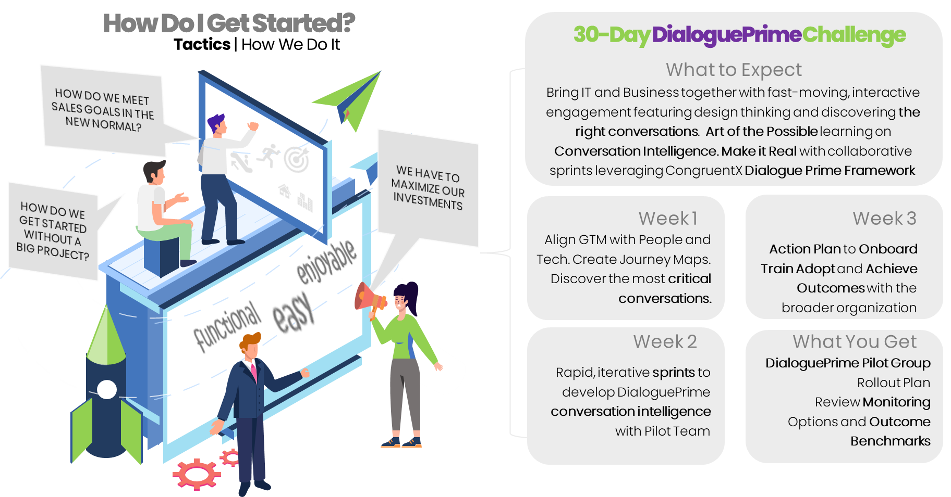

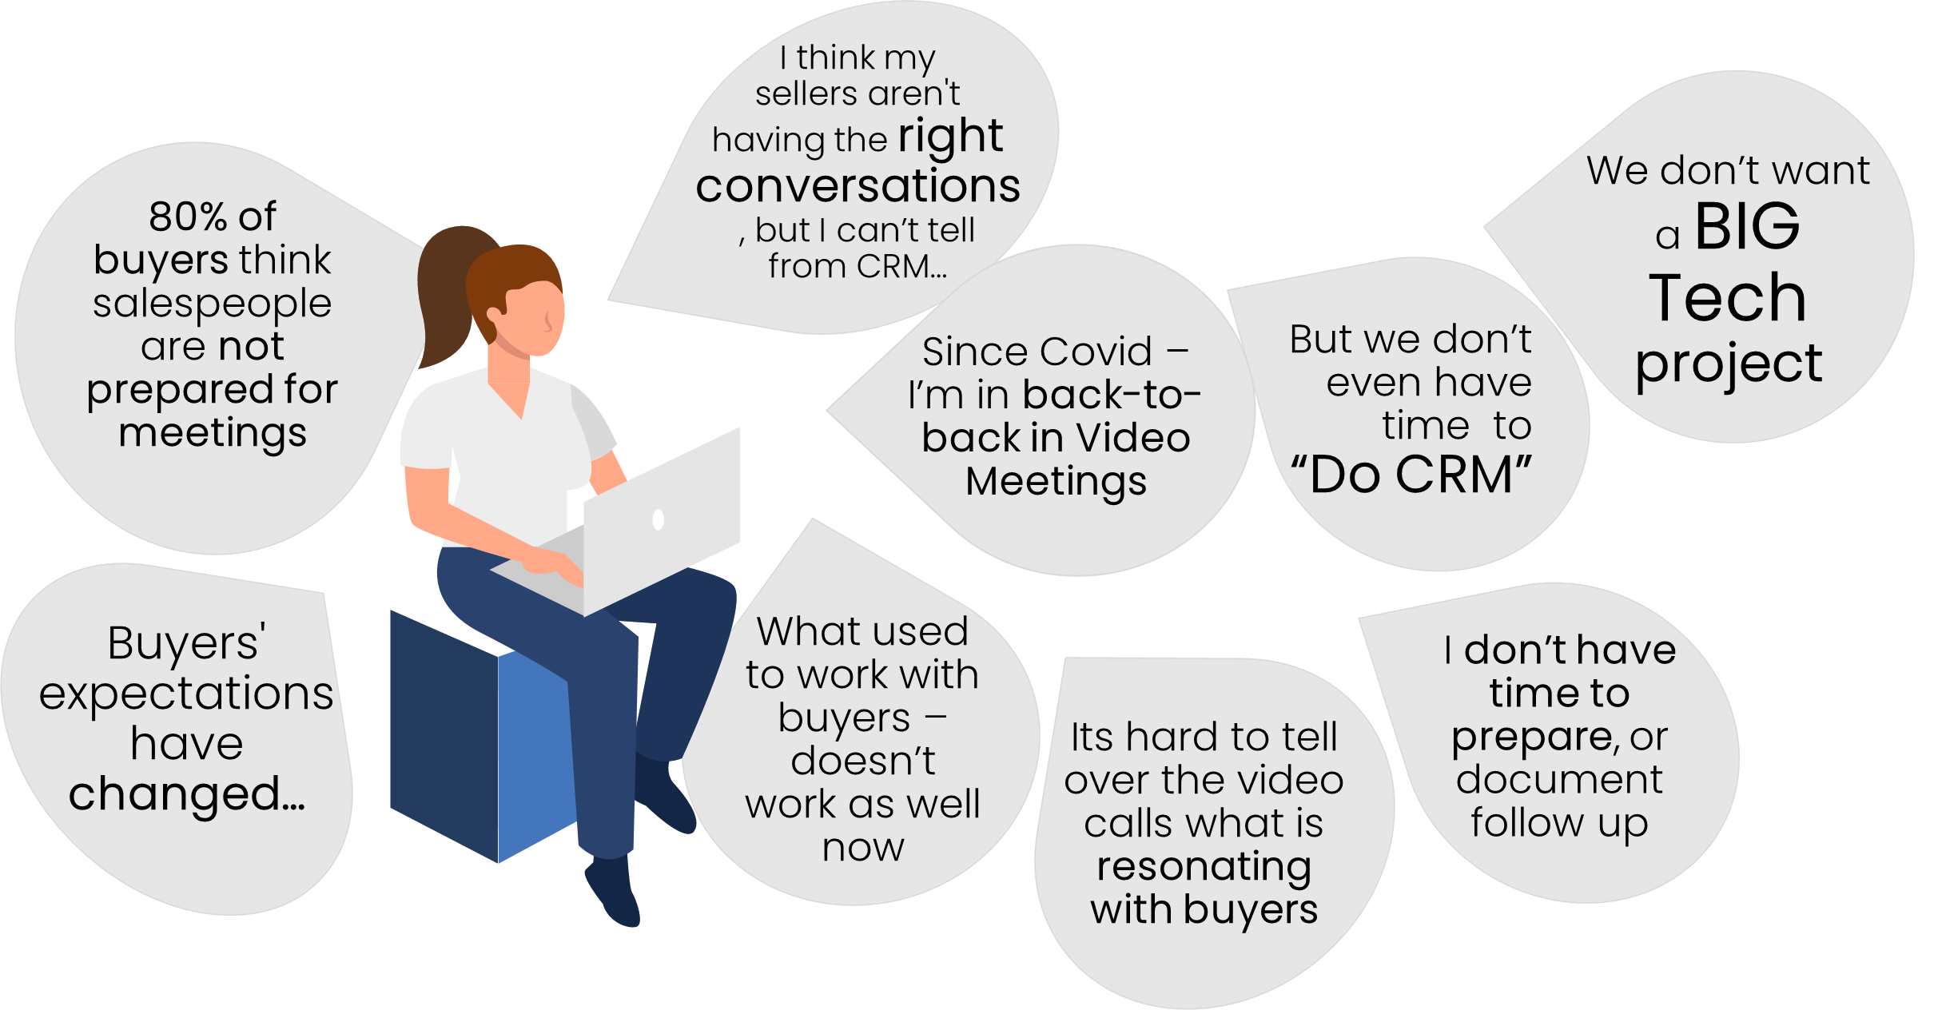
DialoguePrime for GONG
THE CHALLENGE
OUR SOLUTION
DIGITAL SELLING HAS CHANGED …
Are you keeping up?
HAVE THE RIGHT CONVERSATIONS
Get Digital Selling Right
The world has changed… Customer Expectations have shifted from needing information to expecting insights and outcomes. Customers believe salespeople are unprepared for sales calls 82% of the time. One-size-fits-all CRM is not helping. 47% of salespeople think technology is a hinderance, not a help.
For salespeople, however, building relationships and driving revenue is harder in the digital world. Booked all day on video calls with no time to prepare or follow up. The good news is not being in person creates amazing opportunities to use conversational AI to identify, engage and drive revenue. Hence the arrival of DialoguePrime for GONG.
Bring Business and IT professionals together to quickly and measurably talk about how AI can help drive the right conversations. Leverage our DialoguePrime Framework to facilitate the conversations that lead to retention, enrichment, and advocacy.
Structured 30-Day Challenge featuring human-centered design, high engagement, and hands-on experience. Identify aspects of the sales dialogue that represent relationship deterioration or transformation. Benchmarks and actionable insights.
www.congruentX.com mail: info@congruentX.com www.GetCRMRight.com

